Slide 1


STUDENT PORTAL
A Comprehensive Web Application for Student Academic Management.
Presented by:
G. Madhavi

Slide 2
INTRODUCTION
The Student Portal is an online platform that provides students with easy access to academic information and services. It allows students to view courses, check marks.
.

Slide 3
MAIN OBJECTIVE
To develop a role-based web application using Flask where:
Students can register, log in, and view their subject-wise marks and average.
Admins can log in, view the list of students, and add marks for each student.
The application ensures secure login, responsive design, and clean data handling using SQLite and SQLAlchemy.
The interface is designed to be user-friendly and mobile-friendly using Bootstrap.

Slide 4
KEY FEATURES
Student Registration & Login
Course and Subject Info
Admin & Student Dashboards
Marks Upload by Admin

Slide 5
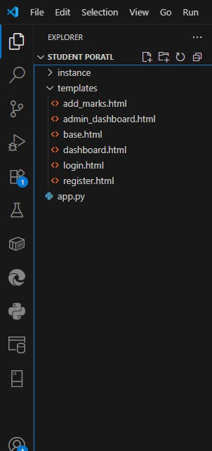
PROJECT STRUCTURE
app.py is the main Flask application that handles routes and core logic.
student_portal.db is an auto-generated SQLite database used to store users and marks.
The templates/ folder contains all HTML pages using Jinja2 for dynamic rendering.
Templates include: login.html, register.html, dashboard.html, admin_dashboard.html, and add_marks.html.
base.html is the layout template reused across all pages for consistency.
This structure cleanly separates frontend design from backend logic.
It ensures better readability, scalability, and easier maintenance of the project.

Slide 6
TECH STACK
Frontend: HTML, CSS
Backend: Flask (Python Web Framework)
Database: SQLite
Tools: VS Code

Slide 7

USER ROLE
Student: Login, view marks
Admin: Manage students, update and add marks

Slide 8

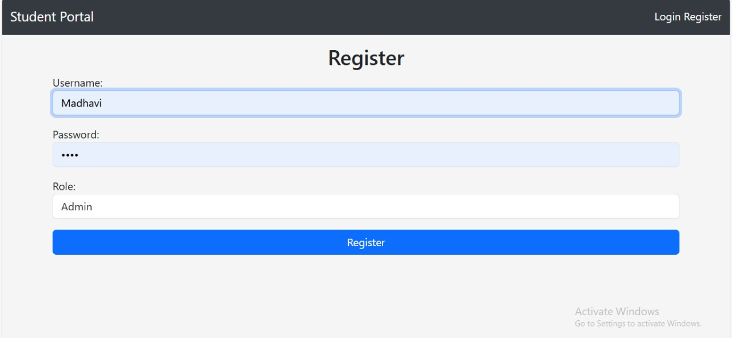
1.Register for admin
PROCESS

Slide 9
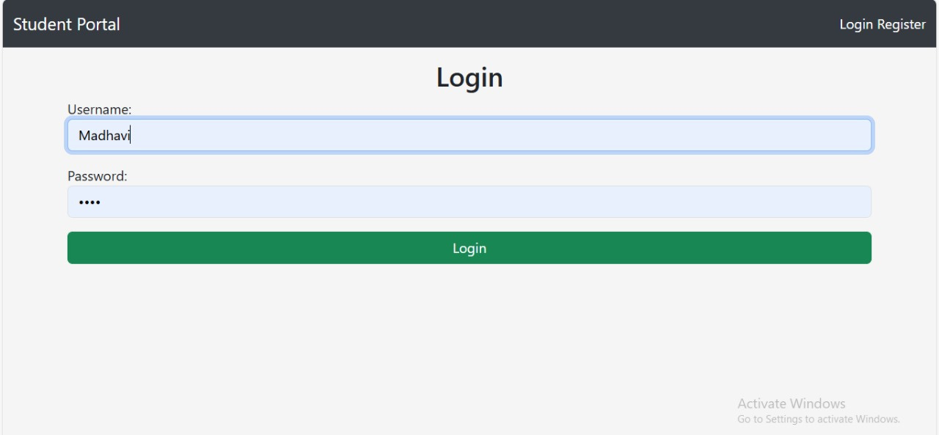
2.Admin Login

Slide 10

Student Register

Slide 11
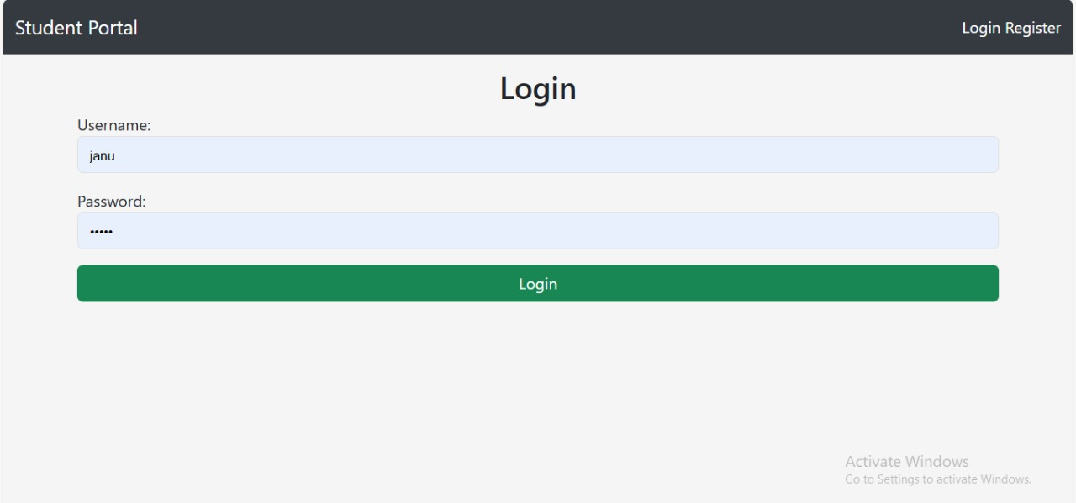
Student login

Slide 12
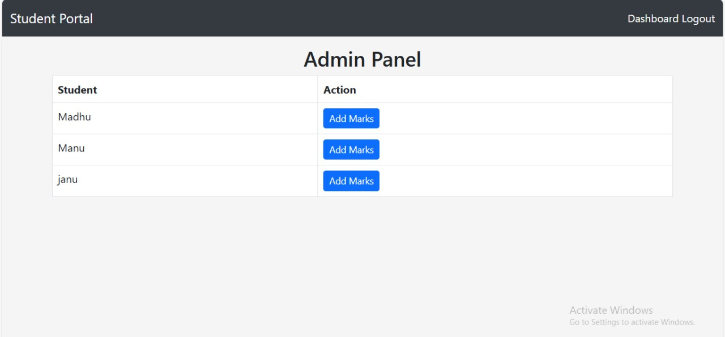
Admin Dashboard

Slide 13
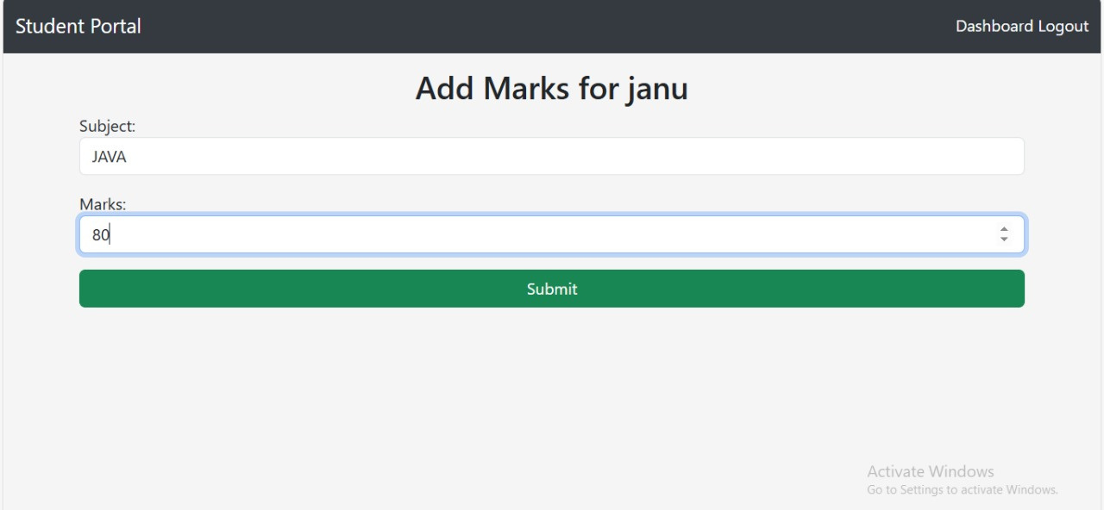
Add Marks of students

Slide 14
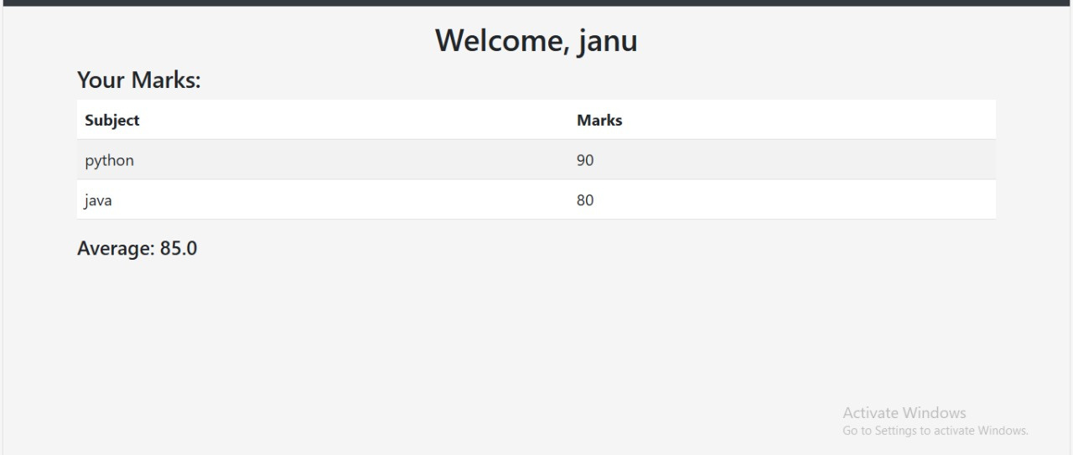
Student page

Slide 15
CONCLUSION
The student portal is a simple and useful platform for students to manage their studies in one place. It helps students and teachers stay connected and share important information easily.

Slide 16

THANK YOU
TRAINED BY:
R. Sravani (Trainer)

